Slide 1

Wine Quality Prediction System
Made by: Ankit Gaur (04720802719)

Slide 2
Content
Company certificate
What is wine? How Quality of wine is tested?
Problem Statement
What is Machine Learning?
Random Forest Model
Workflow
About Dataset
Data collection
Data Analysis and Visualization
Value Distribution Graph
Quality relation graphs
Correlation
Correlation Matrix
Data preprocessing
Label Binarization
Train Test Split
Model Training
Model Testing and Evaluation
Accuracy Score
Other Evaluation Scores
Predictive System
Conclusion
Future Scope

Slide 3
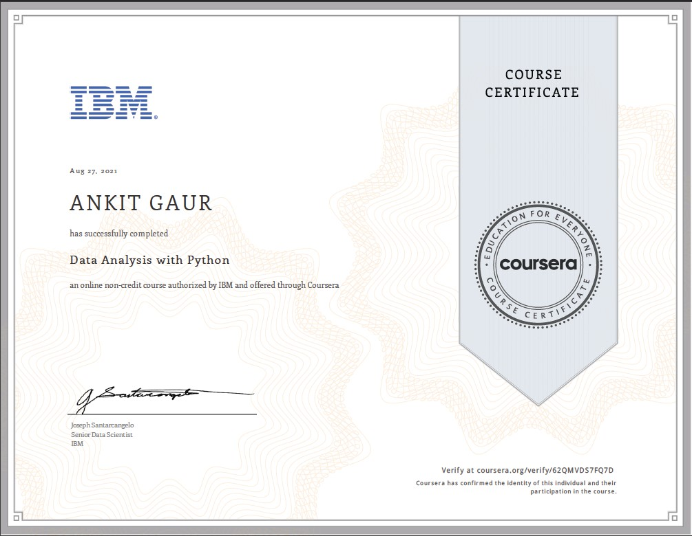
Company Certificate

Slide 4
What is Wine? How Quality of wine is tested?
Wine is an alcoholic drink typically made from fermented grapes.
Wine has been produced for thousands of years. The earliest evidence of wine is from ancient China (c. 7000 BC),Georgia (6000 BC),Persia (5000 BC), and Italy (4000 BC).
Quality of wine is graded based on taste of wine.
Testing of wine quality is done at the end of the production, this is a time taking process and it requires a lot of resources such as the need for various human experts for the assessment of product quality which makes this process very expensive.

Slide 5
Problem Statement
Let’s assume we are working as data scientist in a firm which is going to set up a wine factory in near future. As Testing Quality of wine is crucial for any factory and it takes lot of time and efforts to do testing for samples. Hence, we are asked to make the process of wine quality testing less time consuming, and more cost effective.
We propose to make a wine quality prediction system through which sample quality test is easy, less time consuming, and more cost effective. For this we employed Machine learning classification algorithm named Random Forest. Through this system we can get quality of wine in real time.

Slide 6
What is Machine Learning?
Machine learning (ML) is a type of artificial intelligence (AI) that allows software applications to become more accurate at predicting outcomes without being explicitly programmed to do so. Machine learning algorithms use historical data as input to predict new output values.

Slide 7
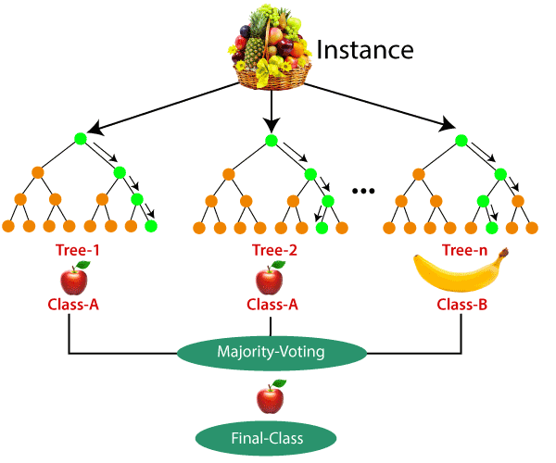
Random Forest Model
Random forest is a method of classification, regression and other task, that operates by constructing a multitude of decision tree at training time and outputting the class that is the mode of the classes (classification) or mean prediction (regression) of the individual trees.
Following are some of the features of random forest algorithm:
It runs efficiently on large datasets.
It gives estimates of what variables are important in the classification
It generates an internal unbiased estimate of generalization error as the first building progress occurs.

Slide 8
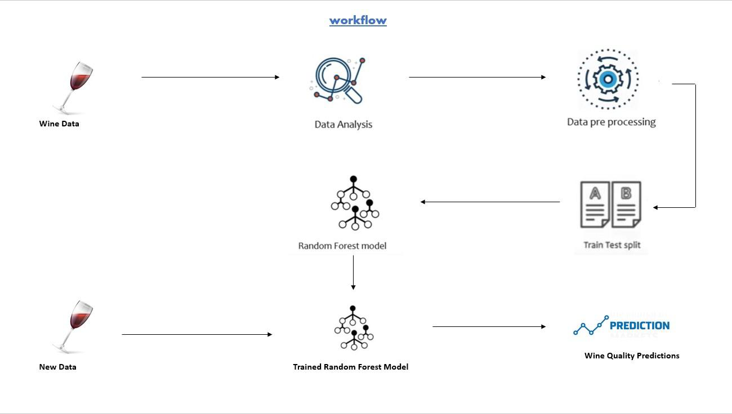
Workflow

Slide 9
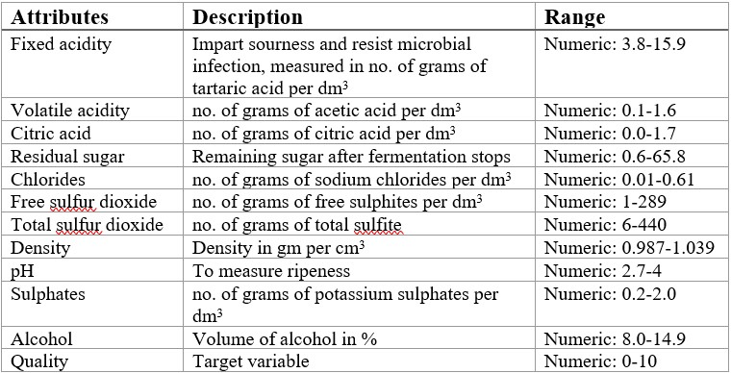
About Dataset
The dataset is related to the red wine of the Portuguese "Vinho Verde" wine. Due to privacy and logistic issues, only physicochemical (inputs) and sensory (the output) variables are available. This dataset can be viewed as classification or regression task. The Data is provided in the form of CSV file.

Slide 10
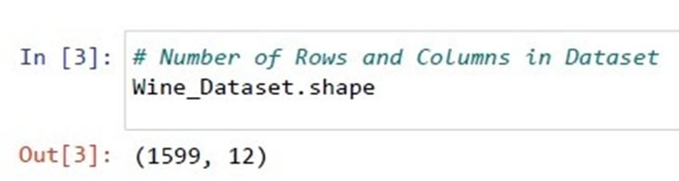
Data Collection
We import our dataset to the program.
Checking the shape of data set for conforming the dataset is loaded properly or not.
This confirms the data is loaded successfully now we are ready to analysis.

Slide 11
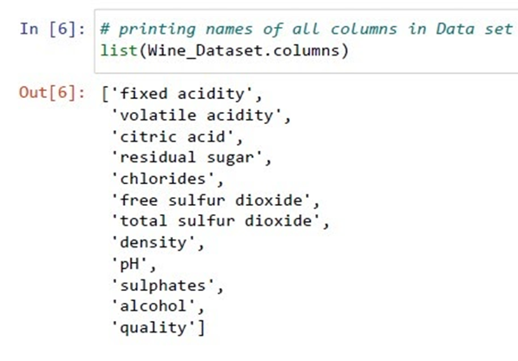
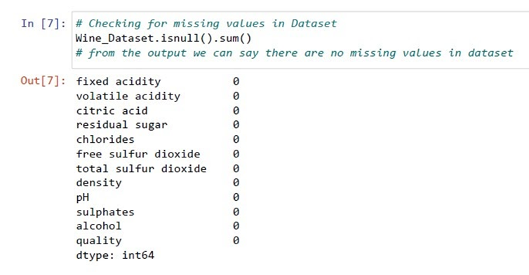
Printing list of columns for getting idea about data
Now we will check for null values in dataset
Here, we can see our dataset is clean it contains no null value in any of the columns

Slide 12
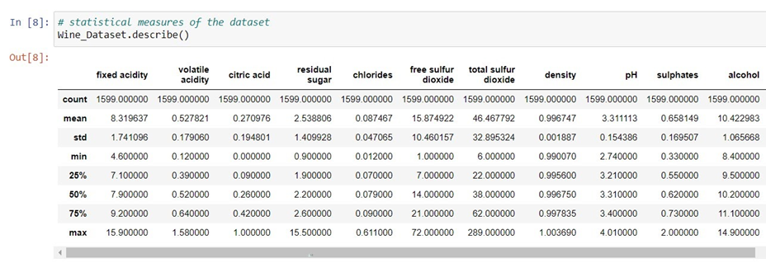
Data Analysis and Visualization
For analysis and visualization let’s start with some statistical Analysis of dataset.
It gives the number of values, mean, standard deviation, minimum value stored, the maximum value stored, value at 25 percentile, 50 percentile, 75 percentile.

Slide 13
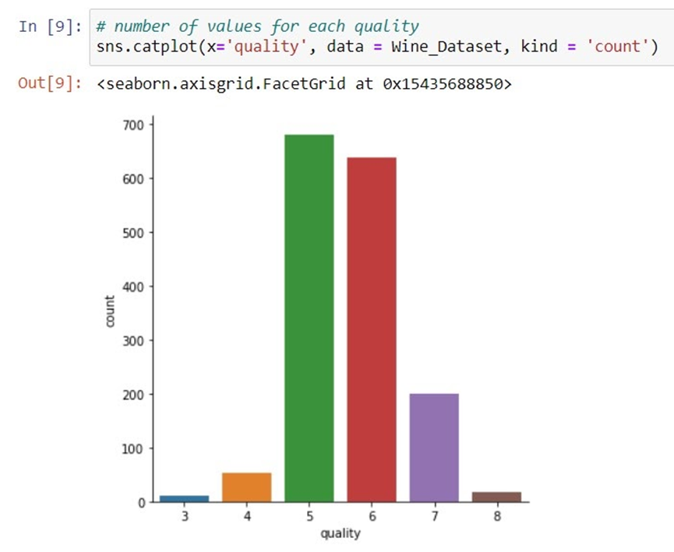
Data Analysis and Visualization
From the graph, we can see it is very rare to have a wine having quality low as 3. At the same time, there is also very rare to have quality high as 7 or 8. Most of the wines in the dataset are average quality that is 5 and 6. So we can divide our quality column into 2 parts such as 6 or above and less than 6 these will show the quality of wine is good or bad respectively.

Slide 14
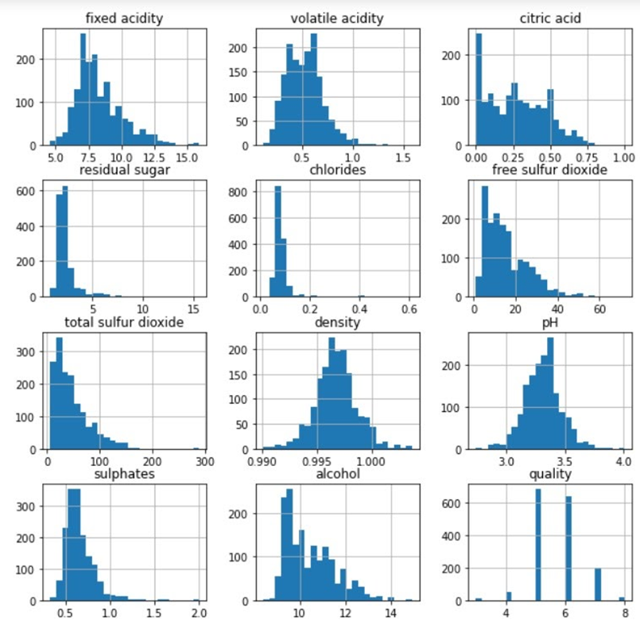
Value distribution graph
These are histograms showing the distribution of all values in each column of the dataset. From these graphs, we can see all values seem continuous but the quality is not continuous rather discrete. This shows all columns except the quality is having floating points due to which the graph seems to be continuous. Also, we can deduce that there are multiple outliers in the graphs.

Slide 15
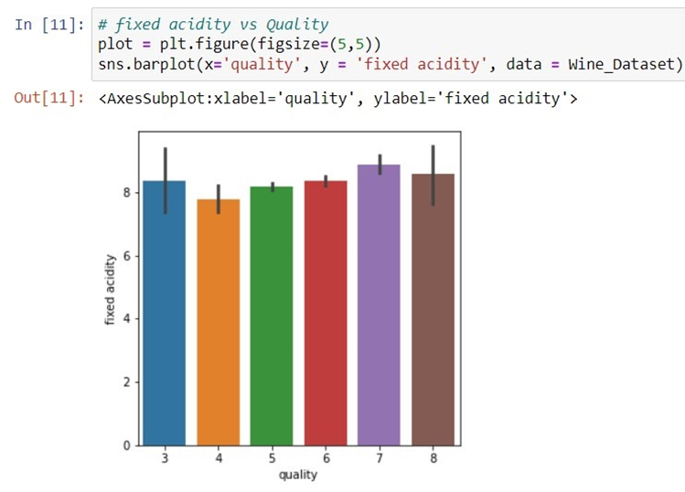
Relation of Fixed acidity with Quality
This graph is a bar plot showing the relation of fixed acidity with quality from the graph we can deduce as quality increase the fixed acidity seems to be changing but true relation can be found only by further analysis

Slide 16
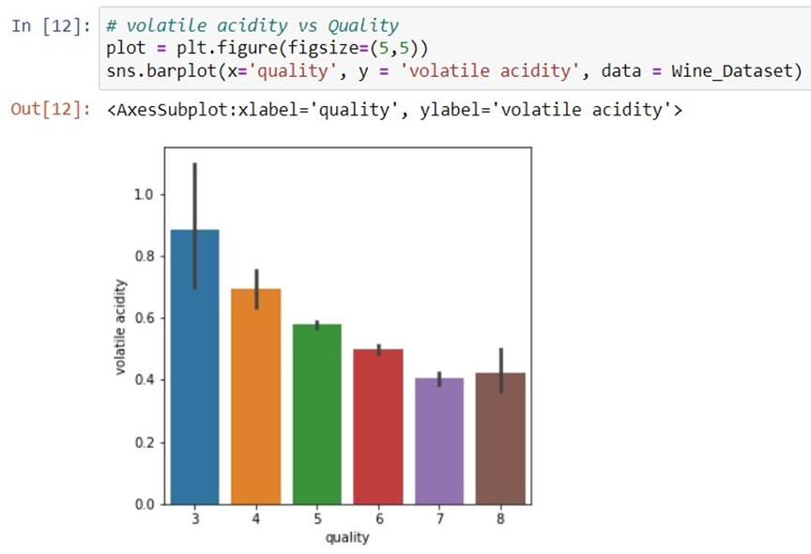
Relation of Volatile Acidity with Quality
This graph is a bar plot showing the relation of volatile acidity with quality from the graph we can deduce as quality increases and the volatile acidity decreases.

Slide 17
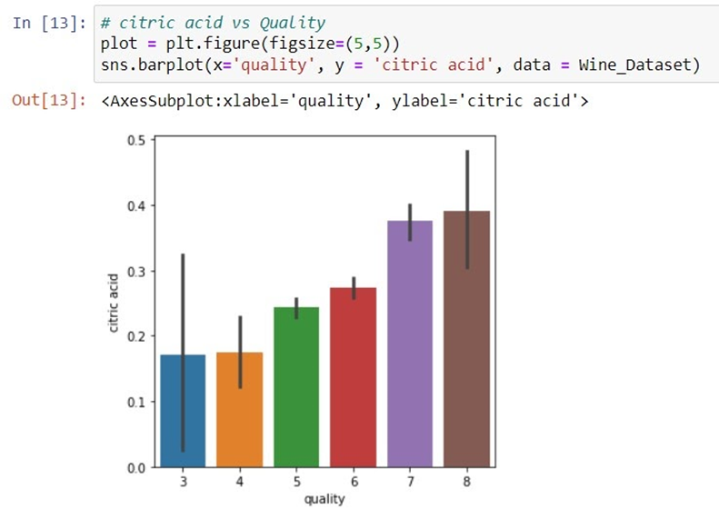
Relation of Citric Acid with Quality
This graph is a bar plot showing the relation of citric acid with quality from the graph we can deduce as quality increases the citric acid increases.

Slide 18
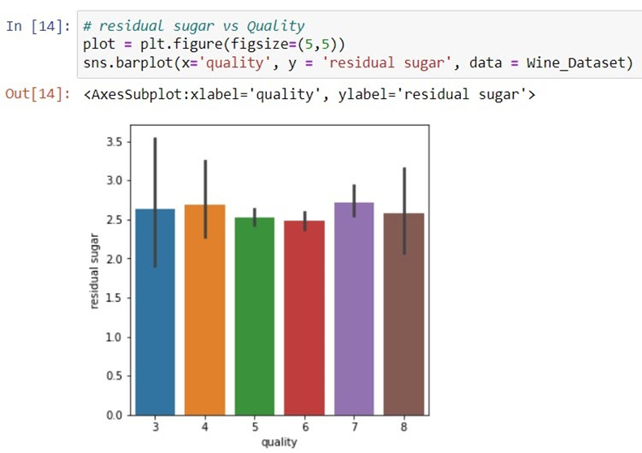
Relation of Residual Sugar with Quality
This graph is a bar plot showing the relation of residual sugar with quality from the graph we can deduce as quality increases the residual sugar seems to be changing but the true relation can be found only by further analysis.

Slide 19
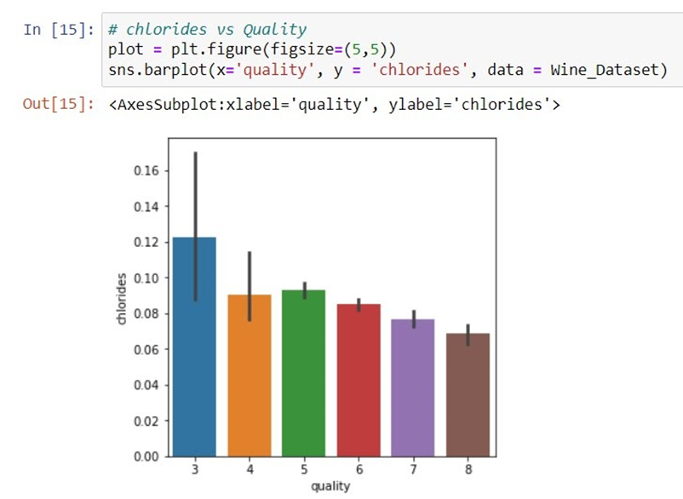
Relation of Chlorides with Quality
This graph is a bar plot showing the relation of chlorides with quality from the graph we can deduce as quality increases and the chlorides decrease.

Slide 20
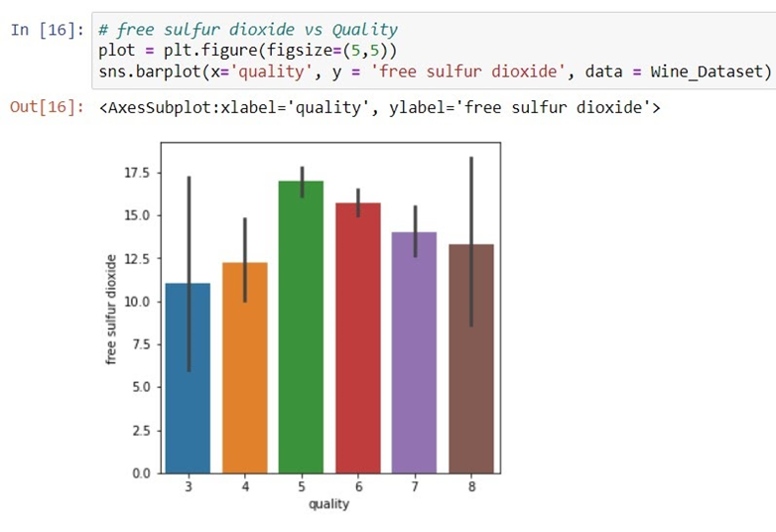
Relation of free sulfur dioxide with Quality
This graph is a bar plot showing the relation of free sulfur dioxide with quality from the graph we can deduce as quality increases the free sulfur dioxide seems to be changing but the true relationship can be found only by further analysis.

Slide 21
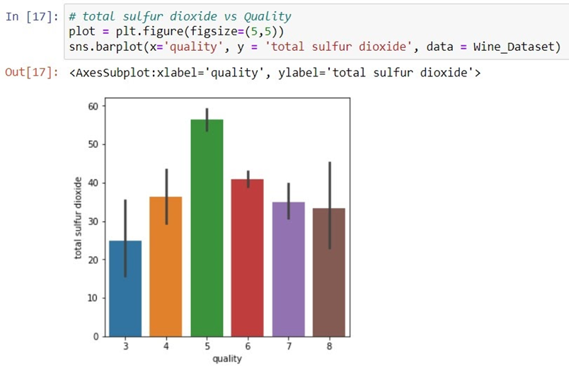
Relation of Total Sulfur dioxide with Quality
This graph is a bar plot showing the relation of total sulfur dioxide with quality from the graph we can deduce as quality increases the total sulfur dioxide decrease.

Slide 22
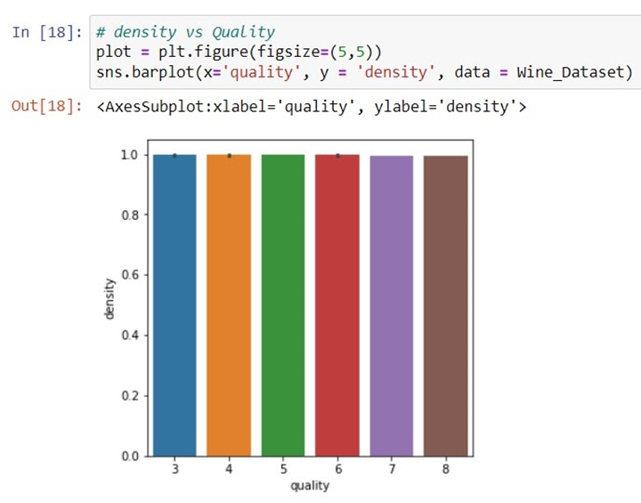
Relation of Density with Quality
This graph is a bar plot showing the relation of density with quality from the graph we can deduce as quality increases the density seems to be changing but the true relationship can be found only by further analysis.

Slide 23
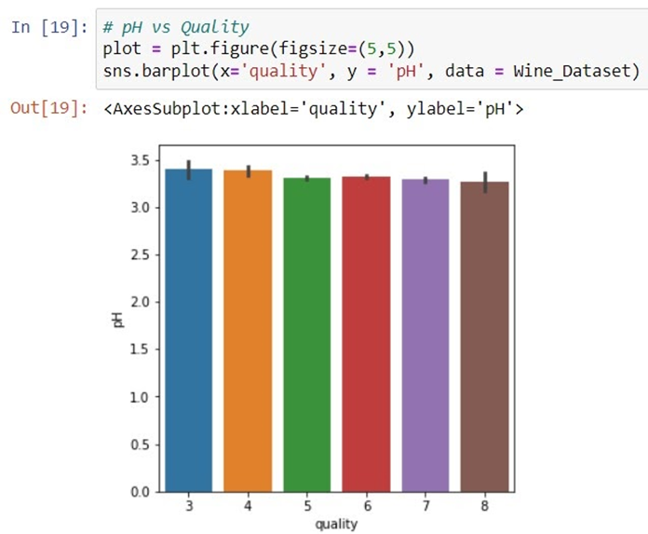
Relation of pH with Quality
This graph is a bar plot showing the relation of pH with quality from the graph we can deduce as quality increases the pH seems to be changing but the true relationship can be found only by further analysis.

Slide 24
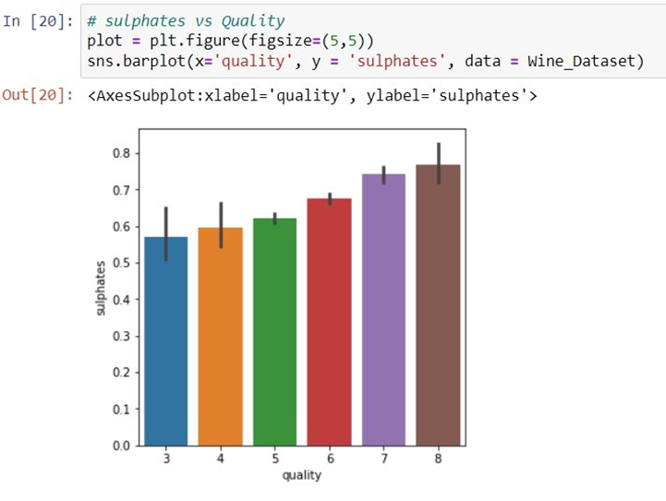
Relation of Sulphates with Quality
This graph is a bar plot showing the relation of sulphates with quality from the graph we can deduce as quality increases the sulphates increase.

Slide 25
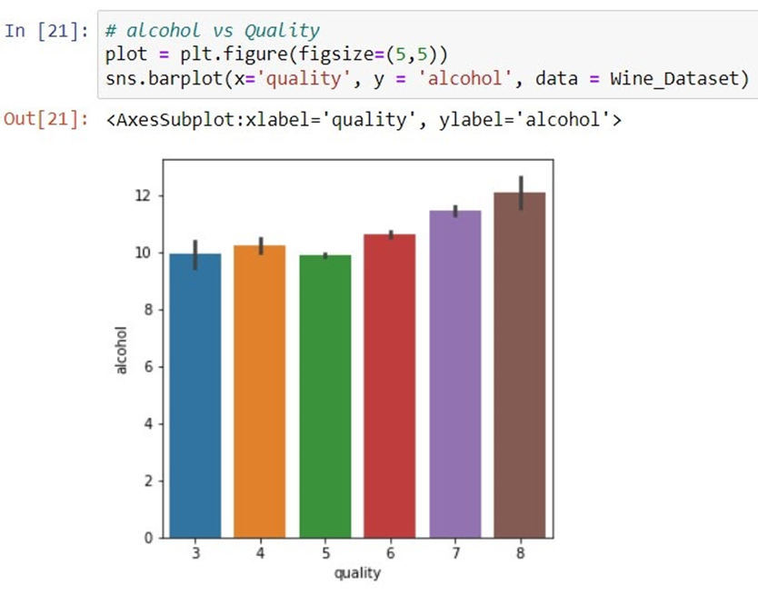
Relation of Alcohol with Quality
This graph is a bar plot showing the relation of alcohol with quality from the graph we can deduce as quality increases the alcohol increase.

Slide 26
Correlation
Correlation explains how one or more variables are related to each other.
These variables can be input data features that have been used to forecast our target variable. If two variables are closely correlated, then we can predict one variable from the other.
Correlation plays a vital role in locating the important variables on which other variables depend.
It’s used as the foundation for various modelling techniques. Proper correlation analysis leads to a better understanding of data.

Slide 27
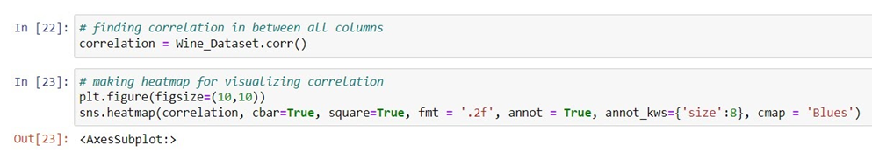
Correlation Matrix
We use the Pearson coefficient correlation matrices to calculate the correlation between the features. A correlation matrix is a table showing correlation coefficients between sets of variables.
This allows us to see which pairs have the highest correlation. The diagonal of the table is always a set of ones because the correlation between a variable and itself is always 1.
Finding a correlation between all the columns in the dataset. The correlation matrix is stored in variable correlation. Then that matrix is plotted using a heatmap.

Slide 28
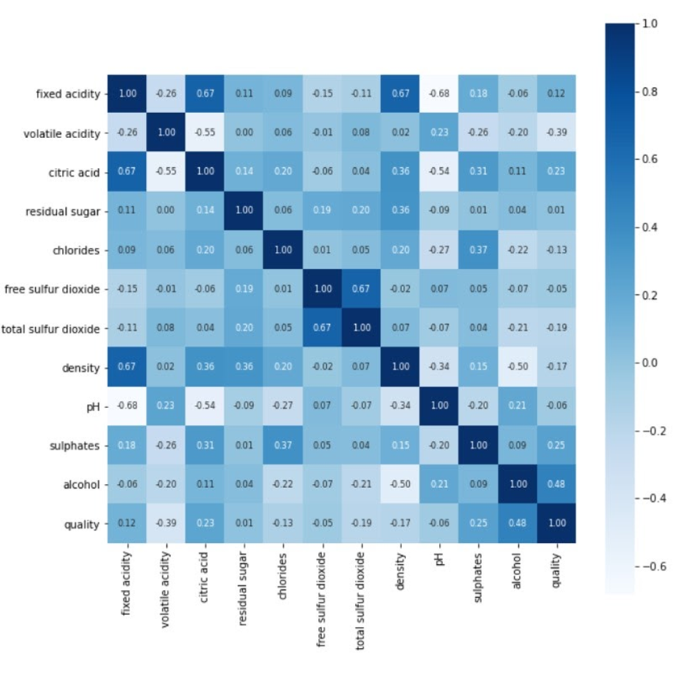
From the heat map, we can see the value of correlation between all the columns. And also we can deduce some attributes have a positive effect on quality such as alcohol, sulphates etc. Some have negative effects on correlation such as volatile acidity, chlorides etc.

Slide 29
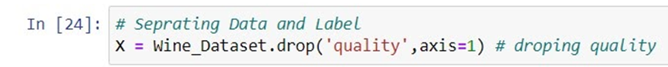
Data preprocessing
Data we collect and analyze is generally raw data. For fitting the data in model we need to do some processing that is known as data preprocessing. It is a crucial step in every machine learning project because if the data is not correctly preprocessed it may lead to complete dysfunction of the model.
In this step, we divide the data into two parts namely data and label. Label is the column that is predicted for a classification model most of the time the values are 0 and 1. Data are the columns that are used to predict the label. These columns have some kind of effect on the label column. Separating data from the label.

Slide 30
Label Binarization
Label Encoding or label Binarization is used to convert the labels into the numeric form to convert it into the machine-readable form. It is an important preprocessing step for the structured dataset in supervised learning. We have used label encoding to label the quality of data as good or bad. Assigning 1 to good and 0 to bad.
Using the lambda function we can convert the quality label to 0 and 1. As we discussed earlier if the quality is greater than equal to 6 quality is good that is 1 and if it's less than 6 then it's bad that is 0.

Slide 31
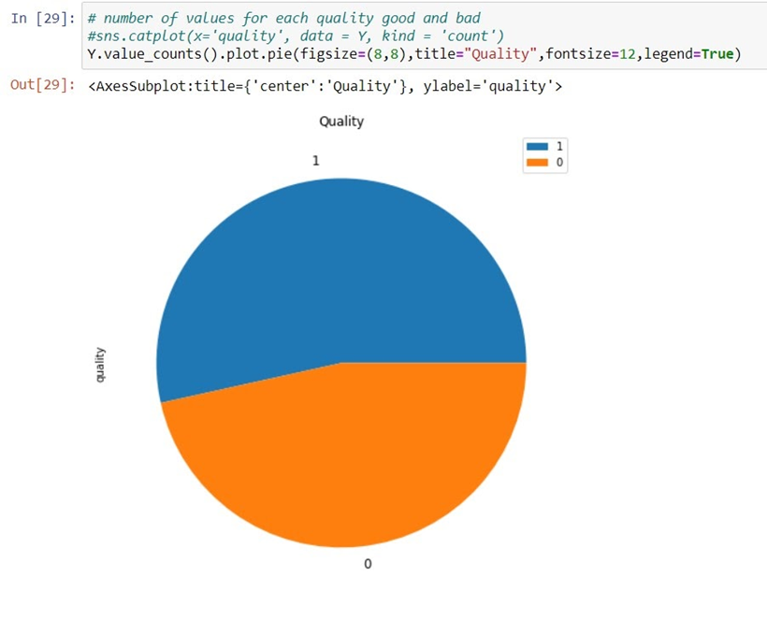
From the pie chart we can see the label binarization completed successfully. Also, we can deduce that more than 50% of the wine is good in our dataset according to our definition of good quality wine.

Slide 32
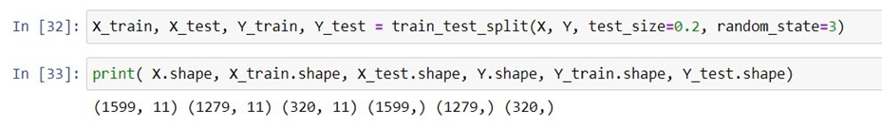
Train Test Split
It is a crucial part of the project as during preparation of a machine learning model we have to provide data to the machine to learn about the data. As a prediction is made we have to check whether the model is learning as we told it to do. That's the place where if we don’t check how our model is behaving on unseen data it may cause an exception in prediction when unseen data is given to the model.
For doing so we do a train test split which gives us 2 data sets, one for training and other for testing. Usually we do a 80:20 split of data but based on the model we used this can be changed. So the predictions made on test date helps us to evaluate our model for real world unseen data.

Slide 33
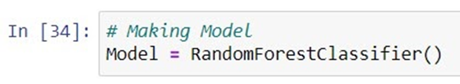
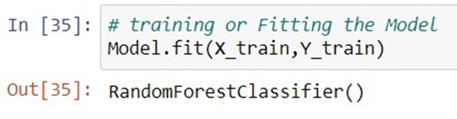
Model Training
It is the phase of a project where machine learn. Here we use the predefined function which contains certain algorithms through which we want to train our machine for the data we provide. First, we create an object or instance of our algorithm.
The second step is to fit the data in the model
Model fitting is a measure of how well a machine learning model generalizes to similar data to that on which it was trained. A well-fitted model produces more accurate outcomes.

Slide 34
Model Testing and Evaluation
Model testing is referred to as the process where the performance of a fully trained model is evaluated on a testing set. The testing set consists of a set of testing samples should be separated from both training and validation sets, but it should follow the same probability distribution as the training set.
The performance measurement is calculated and evaluate the techniques to detect the effectiveness and efficiency of the model. Here, are some matrices we used:
Accuracy is defined as the ratio of correctly predicted observation to the total observation.
Precision is defined as the ratio of correctly predicted positive observations to the total predicted positive observations.
Recall is defined as the ratio of correctly predicted positive observations to all observations in the actual class.
F1 score is the weighted average of precision and recall. The f1 score is used to measure the test accuracy of the model

Slide 35
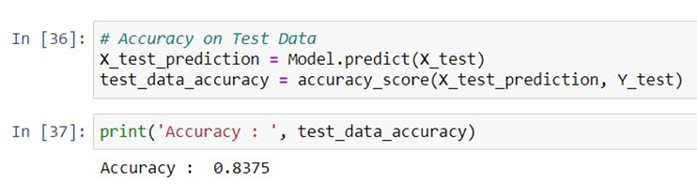
Accuracy Score
Accuracy is defined as the ratio of correctly predicted observation to the total observation. The accuracy can be calculated easily by dividing the number of correct predictions by the total number of predictions. It is a important Evaluation score.
For our model comes out to be 83.75%.

Slide 36
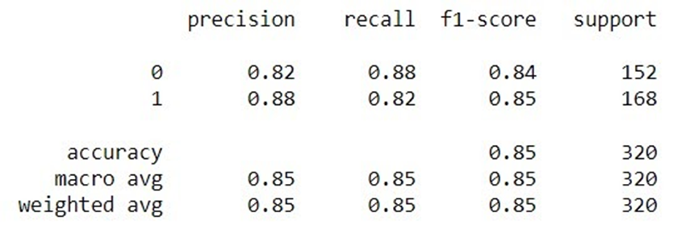
Other Evaluation Score
Here, 0 signifies bad quality 1 signifies good quality.
The precision of the model for predicting bad quality wine is 82% while for good quality wine it’s 88%. While average precision and recall for bad quality wine is 84% and as for good quality is 85% .In total accuracy came out to be 85%.

Slide 37
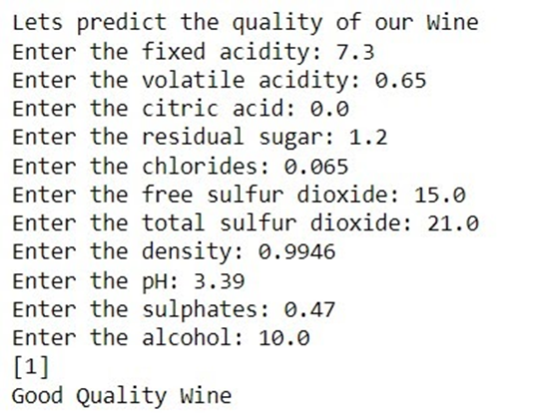
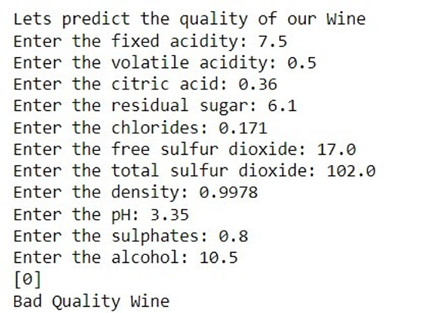
Predictive System
Users have to enter parameters of the wine such as volatile acidity, pH, density etc. then the model will predict the quality of that fine and return whether the wine has good quality or bad quality. The predictions will be accurate to a percentage of more than 80%.

Slide 38
Conclusion
Based on the bar plots, we conclude that not all input features are essential and affect the data, for example from the bar plot against quality and residual sugar we see that as the quality increases, residual sugar is moderate and does not change drastically. So, this feature is not essential as compared to others like alcohol and citric acid, therefore, we can drop this feature while performing feature selection. For classifying the wine quality, we have implemented Random Forest Classifier. We can achieve maximum accuracy of 85% using this model.
At the end we made a predictive system that can be used by any one to have prediction about the quality of the wine they have.

Slide 39
Future scope
In future, by using a more optimized model and better computation techniques we will be able to increase the accuracy of these predictions. Further, we can improve the user interface for a more user friendly and easy to use environment. We can make this system more accessible for users who don’t have needed system configurations and software.

Slide 40
Thank you

